Slide 1
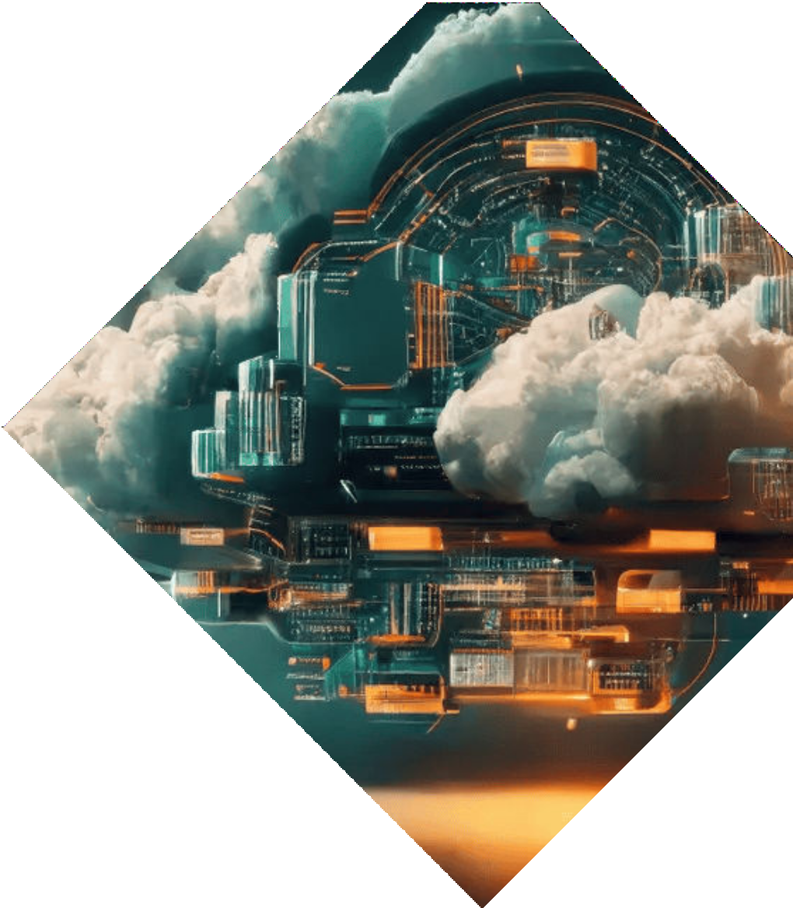

Basic of Cloud Computing

Slide 2
Author
Mohd Farman
Delhi, New Delhi
Data Science Trainee, Meta Scifor Technology
Cyber Review Analyst, Epiq Global
MCA, Galgotias University 2023
BCA, Al Falah University 2021

Slide 3

Introduction to Cloud
Computing
Cloud computing represents a revolutionary shift in how we manage and access data. It enables ﬂexibility, scalability, and cost- eﬃciency for businesses. This presentation will explore the fundamental concepts, beneﬁts, and future trends of this transformative technology.

Slide 4
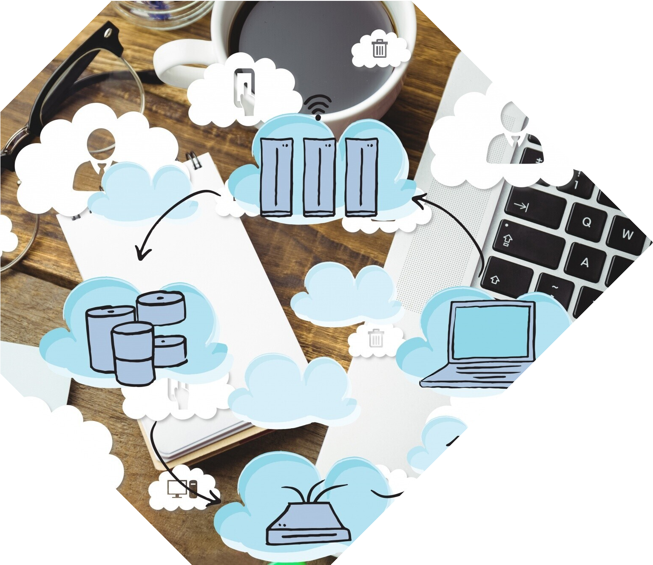

What is Cloud Computing?
Cloud Computing means storing and accessing the data and programs on remote servers that are hosted on the internet instead of the computer’s hard drive or local server, it is a technology where the resource is provided as a service through the Internet to the user. The data that is stored can be files, images, documents, or any other storable document.

Slide 5


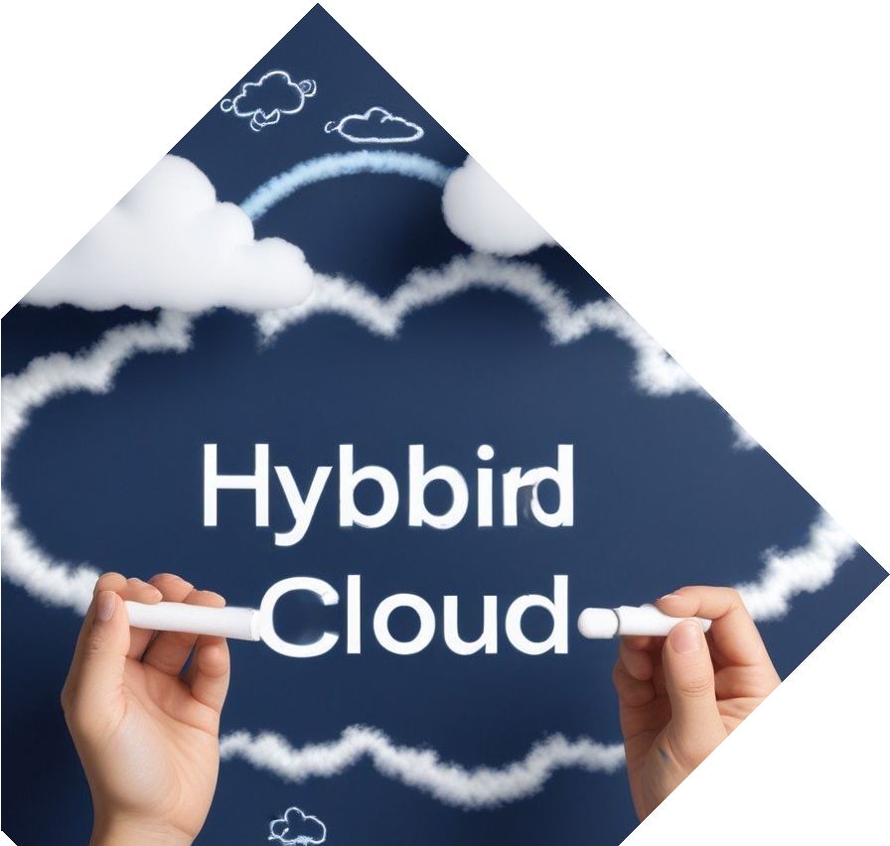
Types of Cloud Models
There are three primary cloud models:
Public, Private, and Hybrid. Public clouds are owned by third-party providers, private clouds are dedicated to a single organization, and hybrid clouds combine both, oﬀering ﬂexibility and control.

Slide 6
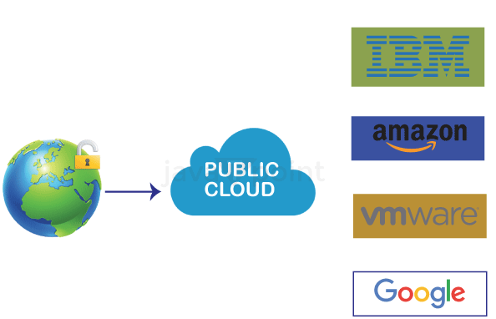
Public cloud
It comes with offering a pay-as-you-go principle for scalability and accessibility of cloud resources for numerous users. it ensures cost-effectiveness by providing enterprise-needed services.
E.g. AWS ,AZURE and IBM Cloud

Slide 7
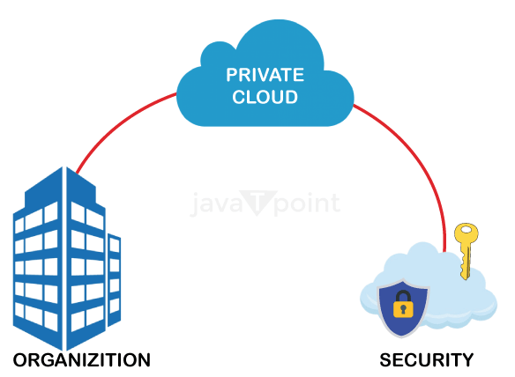
Private cloud
It provides an enhancement in protection and customization by cloud resource utilization as per particular specified requirements. It is perfect for companies which looking for security and compliance needs.
E.g. Legal Organization and IBM

Slide 8
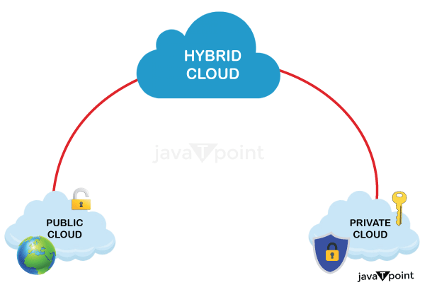
Hybrid cloud
It comes up with a combination of elements of both private and public clouds providing seamless data and application processing in between environments. It offers flexibility in optimizing resources such as sensitive data in private clouds and important scalable applications in the public cloud.
E.g. Amazon, Microsoft, Google, and NetApp.

Slide 9
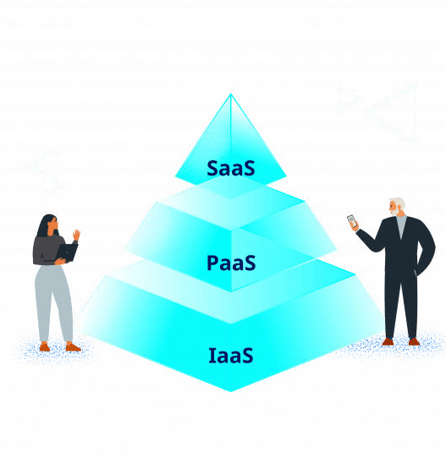
Cloud Computing Services
The main categories of cloud services are IaaS, PaaS, and SaaS. IaaS oﬀers virtualized computing resources, PaaS provides a platform for app development, and SaaS delivers software applications over the internet, enhancing user accessibility.

Slide 10
Cloud Computing Services
IaaS
Infrastructure-as-a-Service provides access to fundamental resources such as physical machines, virtual machines, virtual storage, etc.
IaaS allows the cloud provider to freely locate the infrastructure over the Internet in a cost-effective manner.
PaaS
Platform-as-a-Service offers the runtime environment for applications. It also offers development and deployment tools required to develop applications.
App Engine of Google and Force.com are examples of PaaS offering vendors. Developer may log on to these websites and use the built-in API to create web-based applications.
SaaS
Software-as–a-Service (SaaS) model allows to provide software application as a service to the end users.
SaaS provides us Application Programming Interface (API), which allows the developer to develop a customized application.

Slide 11
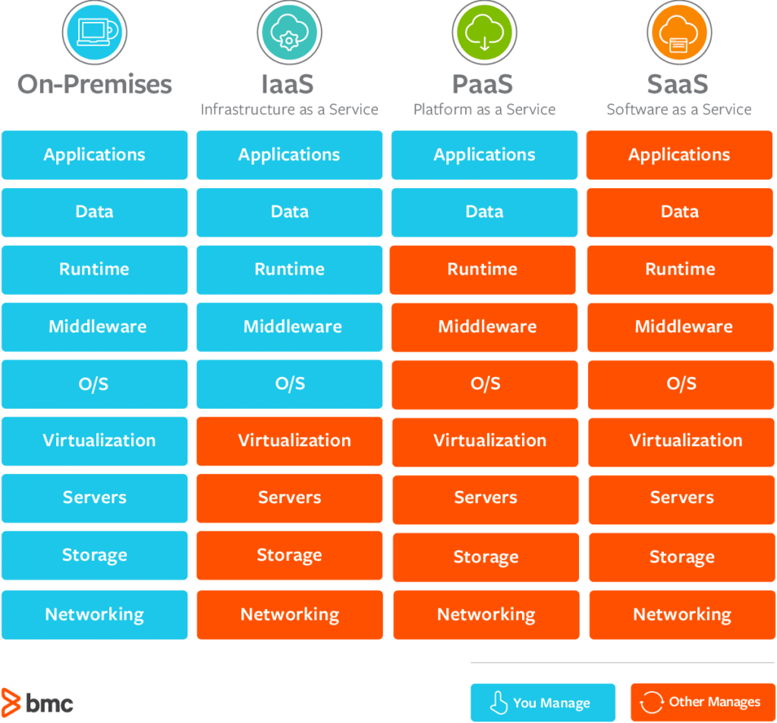

Slide 12
On premises & on cloud
S.No | On Premises | On Cloud
1 | Control of user is more. | Control of user is less as third parties are involved.
2 | Infrastructure is not easy to scale. | Infrastructure is easy to scale.
3 | Internet connectivity is not need all the time. | Internet is must for the services of the cloud.
4 | These services run within the enterprise only. | The services of cloud depends on the third parties so these are not only accessed within the enterprise.
5 | These services are not quite flexible. | services of cloud are highly flexible.
6 | Not available on a subscription basis | Services are available for purchase.
7 | For hardware and software updates, enterprise is responsible. | The For hardware and software updates, third party is responsible.
8 | Cost is fixed. | Cost is not fixed, as additional services comes with additional charges.

Slide 13
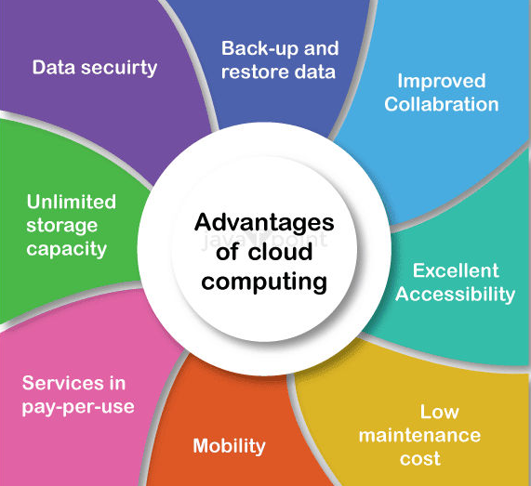
Advantages of Cloud Computing
Cloud computing provides numerous beneﬁts including cost savings, enhanced collaboration, and improved security. Organizations can scale resources quickly and eﬃciently, allowing them to focus on their core business objectives.

Slide 14

Security in the Cloud
Cloud security refers to the cybersecurity policies, best practices, controls, and technologies used to secure applications, data, and infrastructure in cloud environments. In particular, cloud security works to provide storage and network protection against internal and external threats, access management, data governance and compliance, and disaster recovery.

Slide 15


Future Trends in Cloud Computing
The future of cloud computing is bright, with trends like AI integration, edge computing, and serverless architecture gaining traction. These innovations will further enhance performance, reliability, and cost-eﬀectiveness in technology solutions.

Slide 16
Conclusion
In conclusion, cloud computing is not just a trend but a foundation for future technology. Its ﬂexibility, cost-eﬀectiveness, and scalability make it essential for modern businesses. Embracing cloud solutions will pave the way for innovation and growth.

Slide 17
Thanks!
Do you have any questions?
Mohd.farman1010@gmail.com
+91 9718936052

